Slide 1
Cross-Platform Mobile Application Development with Xamarin
Module 3, Lesson 1:
Mobile Development Survey
Notes:
Images and excerpts from Xamarin Mobile Application Development by Dan Hermes, published by Apress
http://www.mobilecsharpcafe.com/xamarin-book/

Slide 2
Topics
Types of Mobile Application Development
Native
Cross-platform
Hybrid

Slide 3
Objectives
In this lesson you will learn about:
Native mobile app development
Cross-platform development
Pros/cons of native app development
Pros/cons of cross-platform development
Common approaches to cross-platform development

Slide 4
Native Mobile Development

Slide 5
Native Application Development
Uses platform-specific and proprietary tools
iPhone: Swift, Objective-C, and Xcode
Android: Java, and Android Studio
Universal Windows Platform: C# and Visual Studio
Notes:
Notes:
The makers of each device develop tools and sometimes even their own languages to make the best applications possible.

Slide 6
Native iPhone Development
Xcode integrated development environment (IDE)
iOS SDK uses the Objective-C/Swift programming languages
https://developer.apple.com/swift/asq
Notes:
Notes:
Other IDEs can be used, but they may not be able to build the code.
Rather than using an IDE, code can be written in a basic text editor.
Add in objective-C/Swift comparison
Why Xcdoe/obj-C/Swift

Slide 7
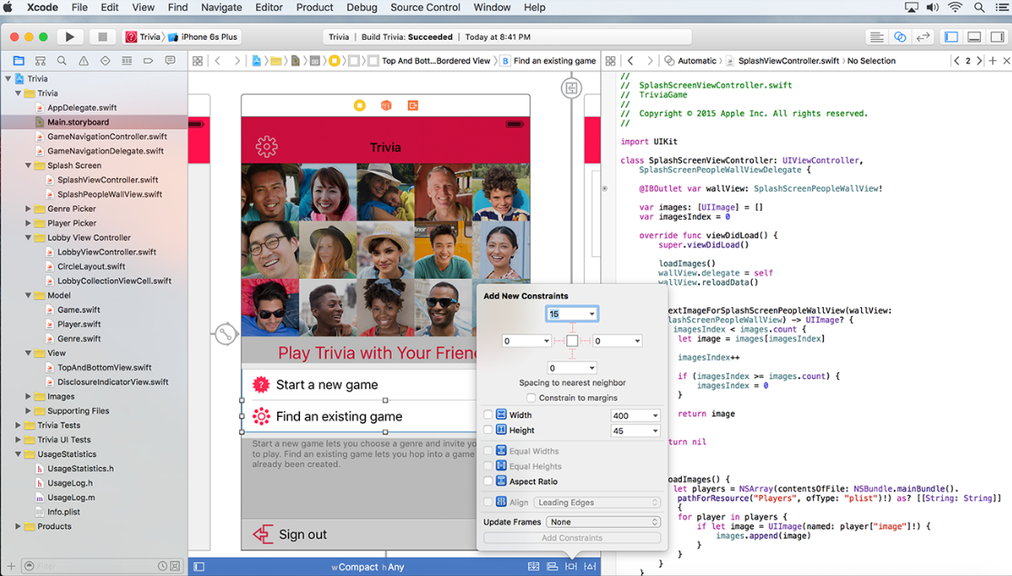
iPhone: Xcode
Notes:
Notes:
Xcode IDE
References:
Image courtesy of Apple

Slide 8
Native Android Development
Android Studio
Android SDK uses the Java programming language
http://developer.android.com/index.html
Notes:
Notes:
Why Eclipse/Java
IDE choices

Slide 9
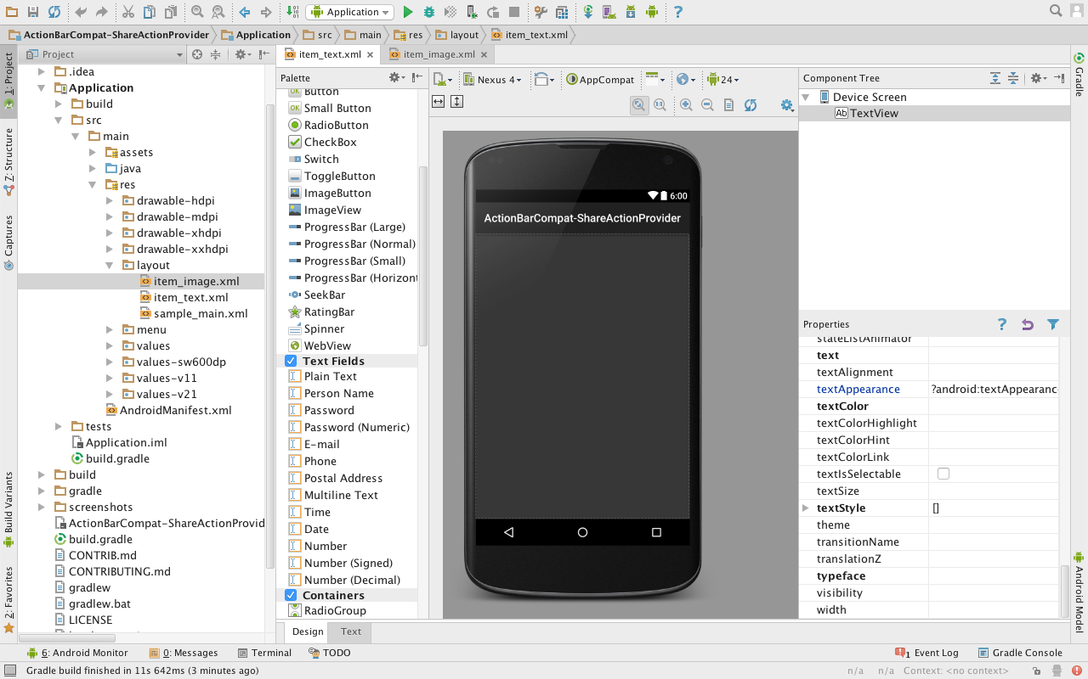
Android: Android Studio
Notes:
References:
Image from Android App Development with Android Studio IDE video with Ronny Kibet

Slide 10
Native Windows Development
Visual Studio IDE
Windows API uses the C# programming language
https://msdn.microsoft.com/en-us/library/windows/apps/ff626516(v=vs.105).aspx

Slide 11
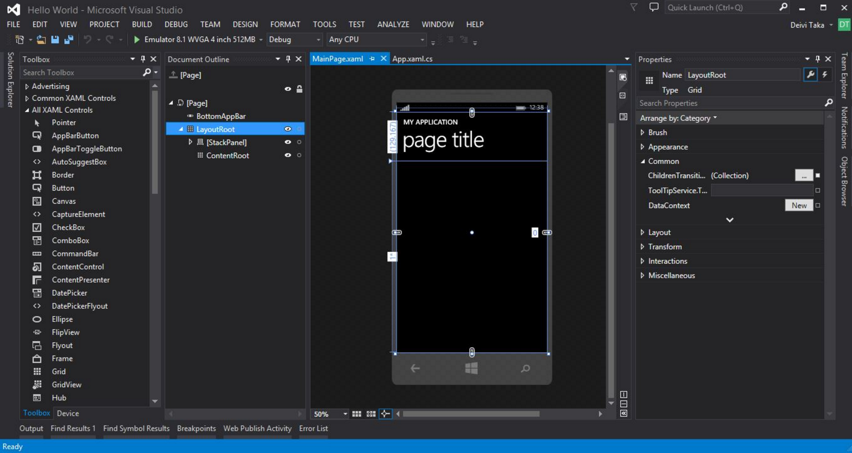
Windows: Visual Studio
Notes:
References:
Image courtesy of Deivi Taka at SitePoint

Slide 12
Benefits of Native Development
Supported by Makers of Device
Highest Quality Applications Possible
They want you to make great apps for their device
Provide support to developer communities
All device features accessible
Optimized for a single platform
All graphics and interactivity features available

Slide 13
Drawbacks of Native Development
Separate Teams
Hard to Reuse Code
Teams have different skills
Use different programming languages
Use different tools
Rewrite all code again for each platform
Code bug fixes and added features separately on all platforms
Notes:
Notes:
Apps developed for particular devices work only on those devices.
Multiple development teams must exist to build the same app for different devices.
Each team is required to use different tools and languages.
Application code cannot be shared due to device differences.
Choosing this approach favors quality over cost and time to market.
Cross-platform core C++ app code is possible, but expensive (AllJoyn).

Slide 14
Native Development Pro/Con Summary
Pros
Cons
High Quality
Performant (Fast)
High-end Graphics and Interactivity
Time-consuming
Costly
Notes:
Notes:

Slide 15
Cross-Platform Mobile Development

Slide 16
Why Cross-Platform Development?
Combine code and development teams
Shared codebase
Same development skillset
Notes:
Notes
Can save time by reusing code
Can save money
Code requires fewer tests
Code reuse increases maintainability

Slide 17
Shared Codebase
One code base works on multiple platforms
Shared code base of data access and business logic
Requires fewer tests
Increases maintainability
{ }
{ }
{ }
iOS
Android
Windows
Shared Code Base
Notes:
Notes:
Many cross-platform mobile frameworks exist, although some don’t support all phones (like Windows).
One code base working on multiple platforms allows some code reuse
Code reuse depends on the framework.
Frequently, web technologies like JavaScript, XML/HTML and CSS are used and don’t necessarily demand use of a particular IDE
IDEs are GUIs that pull together various tools like compilers and designers to enable development of an application.

Slide 18
Same Development Skillsets
Developers can use a single technology to build apps
Android
Java
Diversity of technology is fun for us, the developers
But it can get expensive for companies
A cross-platform approach consolidates the skillsets needed
iOS
Objective C
/Swift
Windows
C#
One programming language and environment
(C# or HTML5 or JavaScript)
Notes:
Notes:
1 language, 1 IDE that can be implemented by different technologies:
Objective C/Swift (or)
Java (or)
C#

Slide 19
Universal Windows Platform (UWP) Apps Run On All Windows 10 Devices
Code in C# using Xamarin in a UWP project
Run on Windows 10 phones and tablets
Run on Windows 10 PCs
Run on Xbox
Run on HoloLens
Notes:
Notes:
Xamarin.Forms with UWP gives us the Windows 10 phones and desktops
Windows 8 and 8.1 phones still work with Xamarin.Forms but require a Windows 8 Phone project type (not a UWP project).

Slide 20
Cross-Platform Solutions
Each framework has its own approach
Development Framework | Defining Characteristics
Xamarin | Code in C# and compile to native
Titanium, NativeScript & React Native | Code in JavaScript and render to native
Cordova | Native shell runs a web app
Notes:
Notes:
Xamarin is the only major framework that compiles to respective native binaries for a 100% native application.
Appcelerator’s Titanium, Telerik’s NativeScript and Facebook’s React Native have 100% native UIs but offshore their logic to the native JavaScript engine.
References:
https://www.xamarin.com/
http://www.appcelerator.com/
https://facebook.github.io/react-native/
https://www.nativescript.org/
https://cordova.apache.org

Slide 21
Xamarin
Code in C#
Compile to a native executable
Create a native app for each platform
{ }
{ }
{ }
iOS
C# UI
Android
C# UI
Windows
C# UI
Xamarin Approach
Native with Code Sharing
Shared C# Code
Notes:
Notes:
Xamarin backend is mostly shared code, though some platform-specific code may be necessary.
UI code can be shared with Xamarin.Forms (explained in a later lesson); otherwise, UI code is platform-specific.
C# UI piece is much more complex – Layouts & XAML, etc.
Code reuse among the UIs is achievable (also explained later).
Make stacked diagram for each approach.

Slide 22
Titanium, NativeScript, React Native
Two sides of development:
Native app shell
XML (or similar) translated to native UIs
Core logic and UI handled by native JavaScript engine
JavaScript used as-is or compiled to native language
Controls platform-specific UI using proprietary OS API binding
JavaScriptCore (iOS), V8 (Android), Chakra (Windows)
Notes:
Notes:
These front-end shells represent essentially two apps: the native app and JavaScript app.
Native app is just a UI.
JavaScript app handles all the logic, web requests, data handling, etc.
Functions are extremely similar for all three frameworks.
References:
http://developer.telerik.com/featured/nativescript-works/

Slide 23
Cordova Hybrid Framework
Web app running within a native shell
HTML and JavaScript UI
Native shell allows app store distribution
JavaScript API communicates with device using OS API
Cordova is the most commonly used hybrid framework
Native App Shell
Native WebView
Web App
Notes:
Notes:
JavaScript API:
Basic support for device features
Native plugins can be built to add support for other features
PhoneGap was the old name for Cordova. Apache acquired and then renamed it.
PhoneGap is currently a distribution of Cordova.
PhoneGap is Cordova with Apache tools on top of it (like PhoneGap Build) .
Cordova is essentially the only hybrid framework.
Almost all other hybrid frameworks are built on top of it to reduce the pains of hybrid development
UI frameworks are built on top of Cordova to make them look and feel like a real, native app instead of a website.
Frameworks built on top of Cordova:
PhoneGap
Ionic
Onsen
Many others
References:
https://cordova.apache.org/
http://ionicframework.com/
https://onsen.io/

Slide 24
Pros and Cons
How cross-platform development frameworks stack up
Framework | Advantages | Disadvantages
Xamarin | Performant, enterprise-grade foundation, reliability and comfort of C#, cross-platform UI or 100% access to APIs, truly native apps | Can require knowledge of native platforms, third-party integrations require C# bindings
Titanium, NativeScript, React Native | Well-known language (JavaScript), Shield developer from native API, Native apps | Uneven performance, Lightweight language, Not type-safe
Cordova | Good transition from web development, Rapid prototyping | Uneven performance, Not truly native apps, Look and feel not native
Notes:
Notes:
Xamarin is the only major framework that compiles to respective native binaries for a 100% native application.
Appcelerator’s Titanium, Telerik’s NativeScript and Facebook’s React Native have 100% native UIs but offshore their logic to the native JavaScript engine.
References:
https://www.xamarin.com/
http://www.appcelerator.com/
https://facebook.github.io/react-native/
https://www.nativescript.org/
https://cordova.apache.org

Slide 25
Choosing Xamarin
Many developers and companies are choosing Xamarin
Because Xamarin provides:
A truly native app experience as the end goal
Fast apps without too much tuning
Development using an industrial-strength framework: .NET
Programming using a comfortable, heavyweight language: C#

Slide 26
Quiz
What is the biggest advantage of writing separate mobile applications in their native languages?
a. It’s the cheapest option
b. It’s the least time-consuming option
c. Provides the highest quality experience possible
Notes:
Answer: c

Slide 27
Quiz
What is true of hybrid mobile applications?
a. Host locally-installed web apps
b. Compiles to native binaries
c. Provides native user interfaces
Notes:
Answer: a

Slide 28
Quiz
Which is true of technologies like Appcelerator’s Titanium, Telerik’s NativeScript, and Facebook’s React Native?
a. C# is the main language used
b. Primarily uses WebViews to host UI
c. Provides native user interfaces
Notes:
Answer: c

Slide 29
Quiz
Which is true of Xamarin?
a. C# is the main language used
b. Compiles to native executables
c. Primarily uses WebViews to host UI
d. Only a and b.
Notes:
Answer: d

Slide 30
Summary
In this lesson you have learned about:
Native mobile app development
Cross-platform development
Pros/cons of native app development
Pros/cons of cross-platform development
Common approaches to cross-platform development

